Slide 1
The Transport Layer
Chapter 6

Slide 2
The Transport Service
Services Provided to the Upper Layers
Transport Service Primitives
Berkeley Sockets

Slide 3
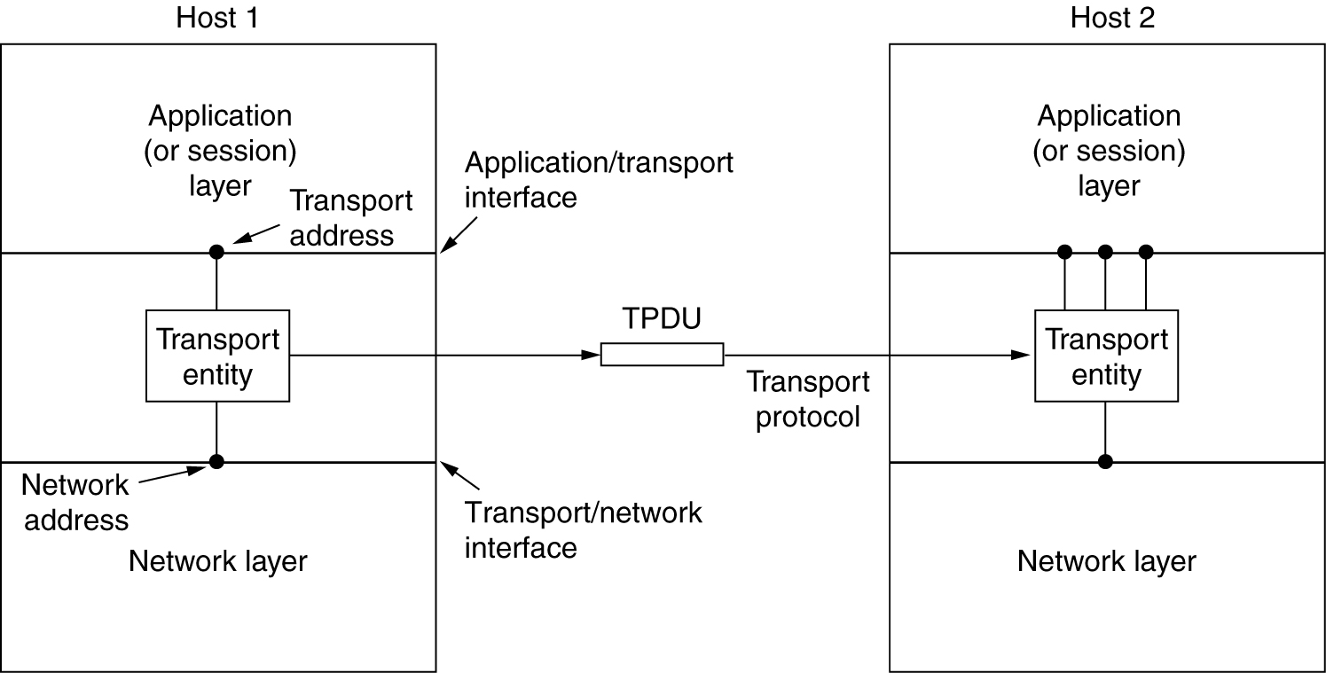
Services Provided to the Upper Layers
The network, transport, and application layers.

Slide 4
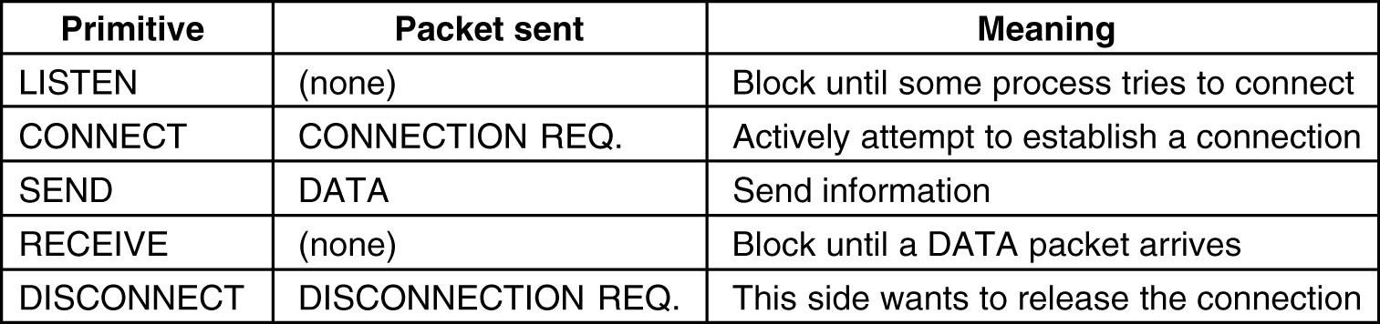
Transport Service Primitives
The primitives for a simple transport service.

Slide 5
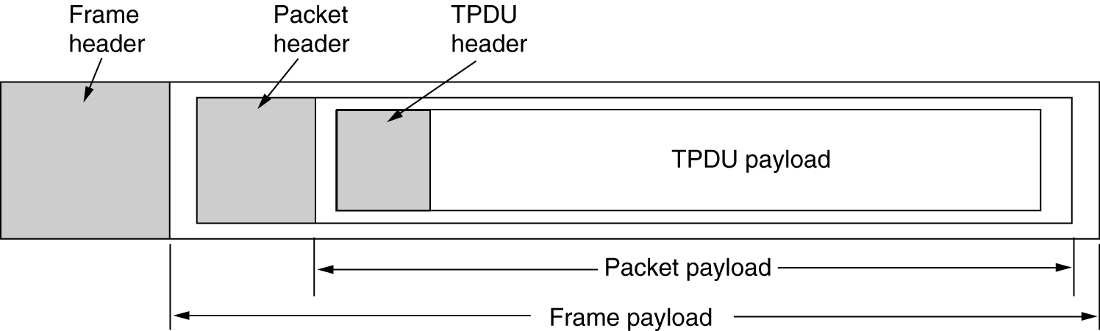
Transport Service Primitives (2)
The nesting of TPDUs, packets, and frames.

Slide 6
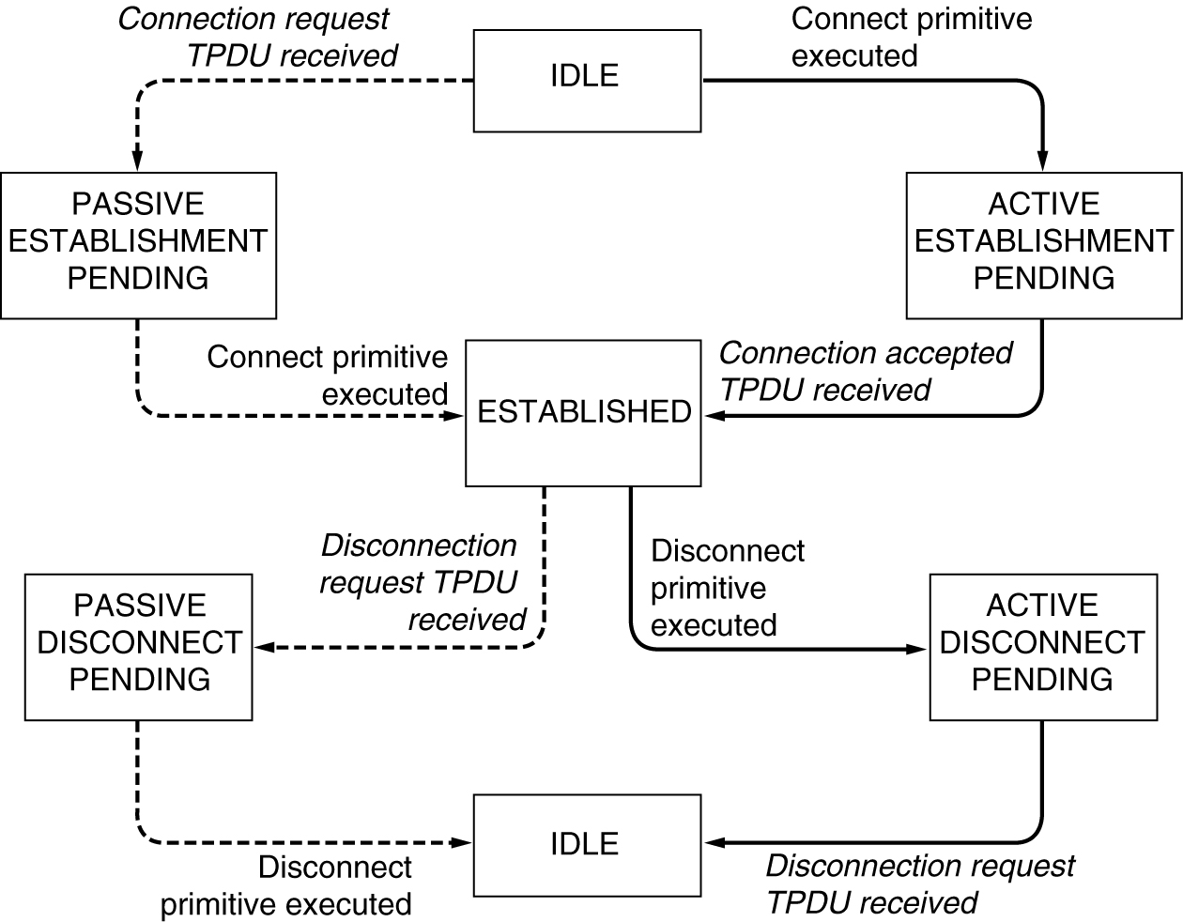
Transport Service Primitives (3)
A state diagram for a simple connection management scheme. Transitions labeled in italics are caused by packet arrivals. The solid lines show the client's state sequence. The dashed lines show the server's state sequence.

Slide 7
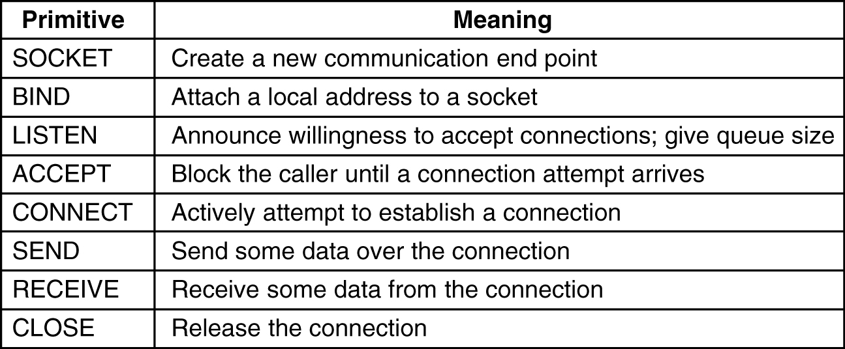
Berkeley Sockets
The socket primitives for TCP.

Slide 8
Elements of Transport Protocols
Addressing
Connection Establishment
Connection Release

Slide 9
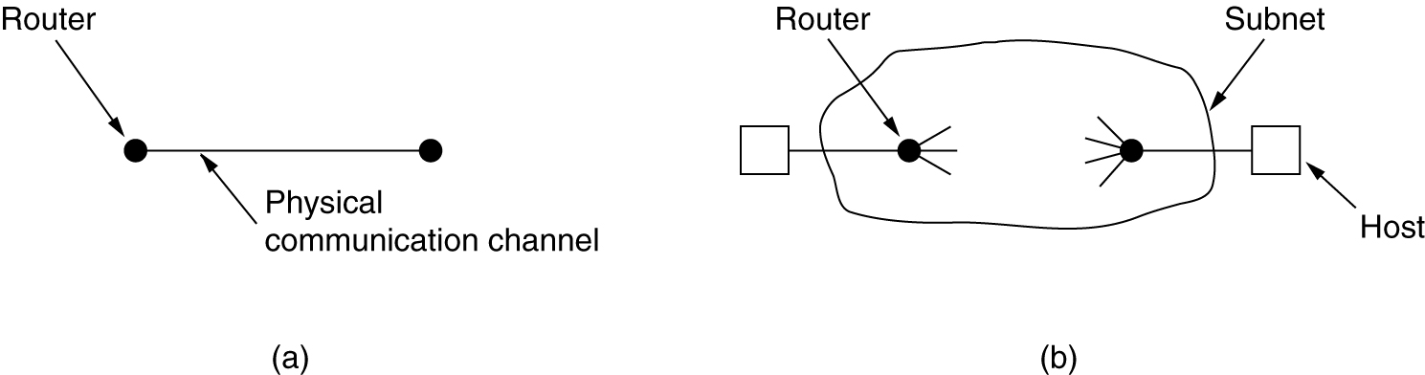
Transport Protocol
(a) Environment of the data link layer.
(b) Environment of the transport layer.

Slide 10
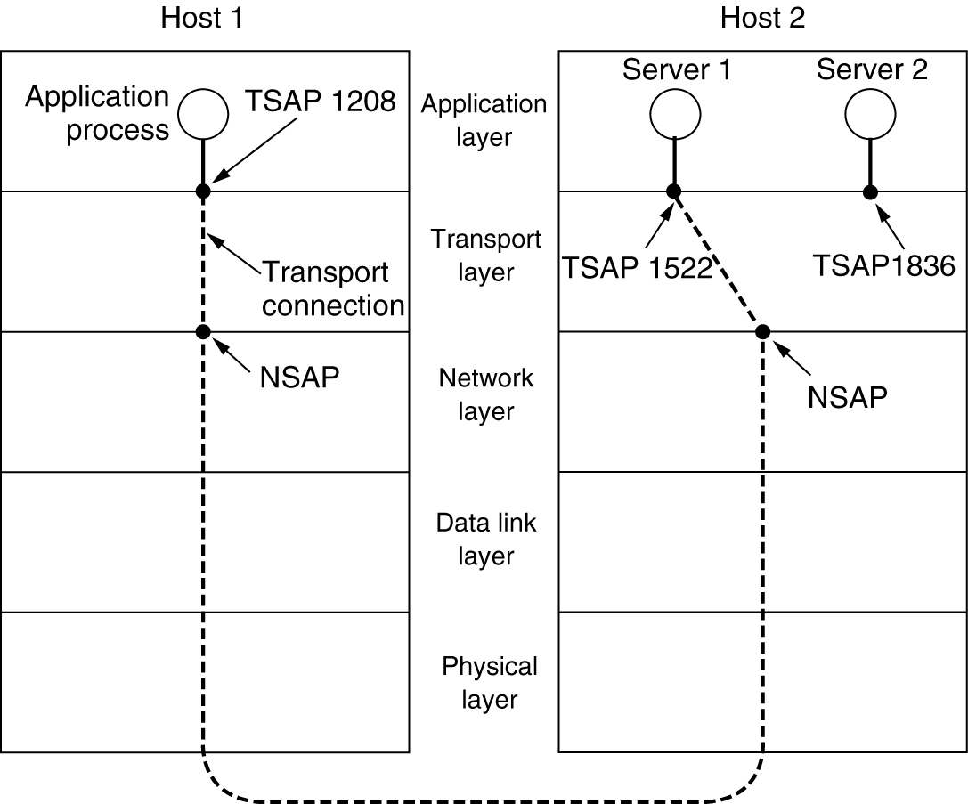
Addressing
TSAPs, NSAPs and transport connections.

Slide 11
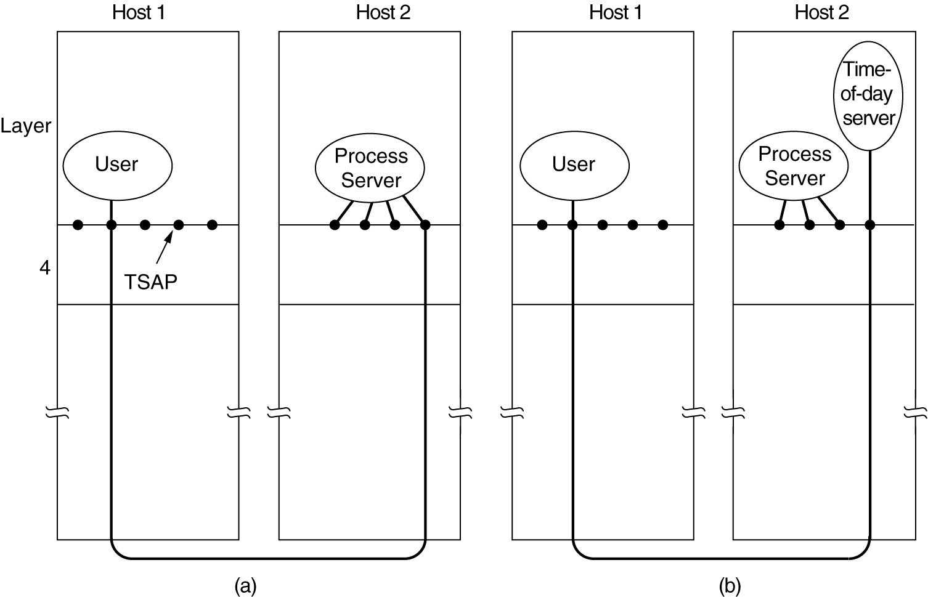
Connection Establishment
How a user process in host 1 establishes a connection with a time-of-day server in host 2.

Slide 12
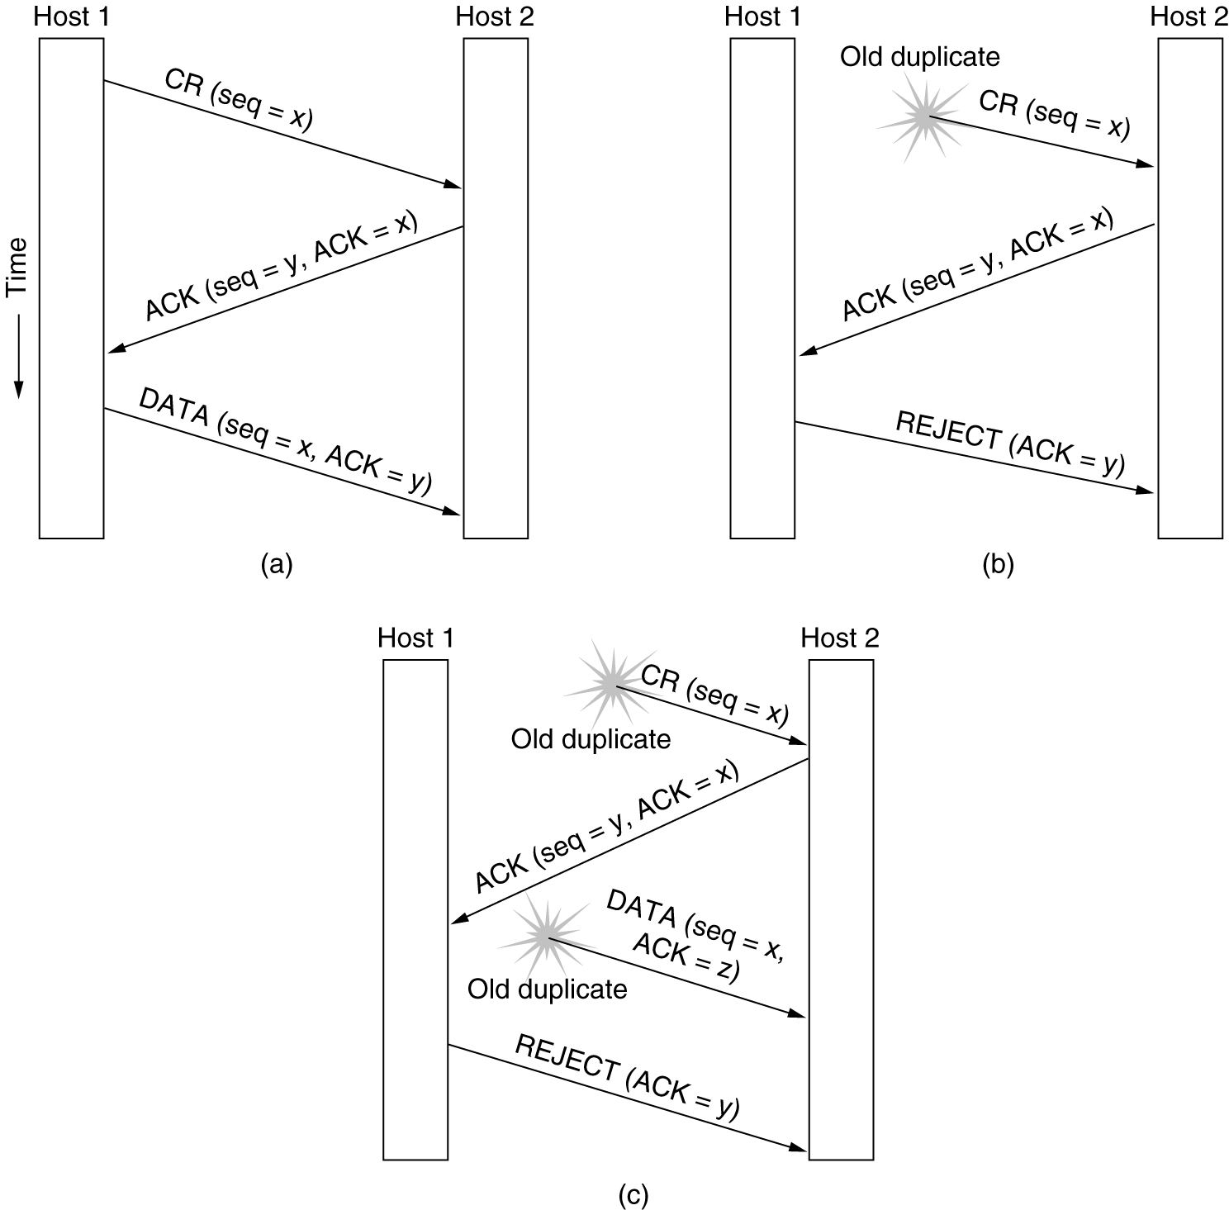
Connection Establishment (3)
Three protocol scenarios for establishing a connection using a three-way handshake. CR denotes CONNECTION REQUEST.
(a) Normal operation,
(b) Old CONNECTION REQUEST appearing out of nowhere.
(c) Duplicate CONNECTION REQUEST and duplicate ACK.

Slide 13
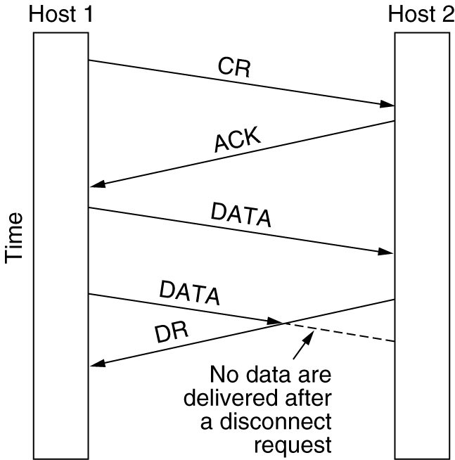
Connection Release
Abrupt disconnection with loss of data.

Slide 14
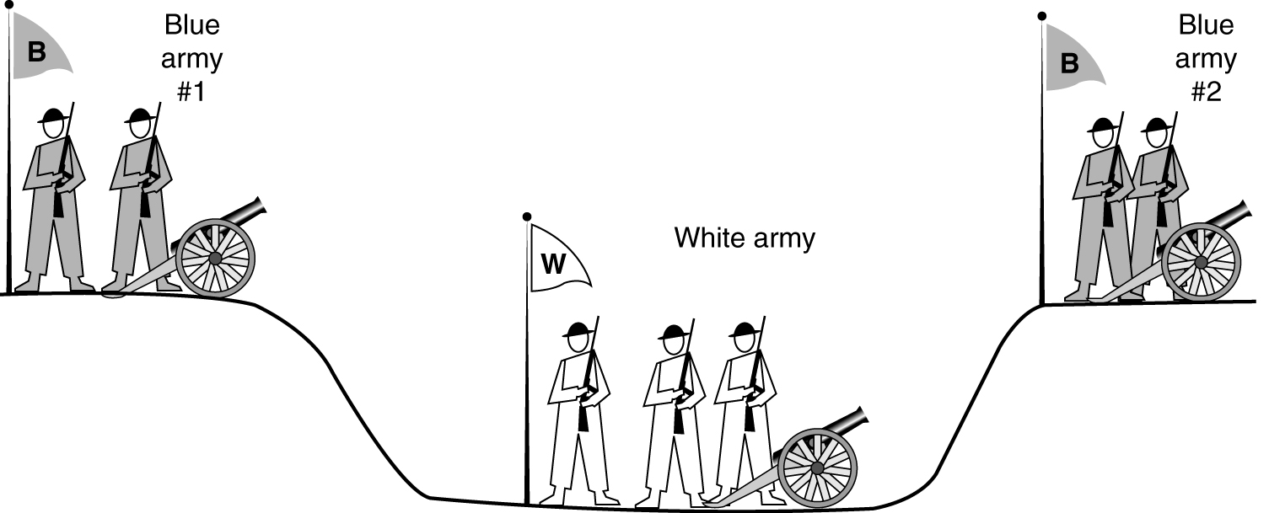
Connection Release (2)
The two-army problem.

Slide 15
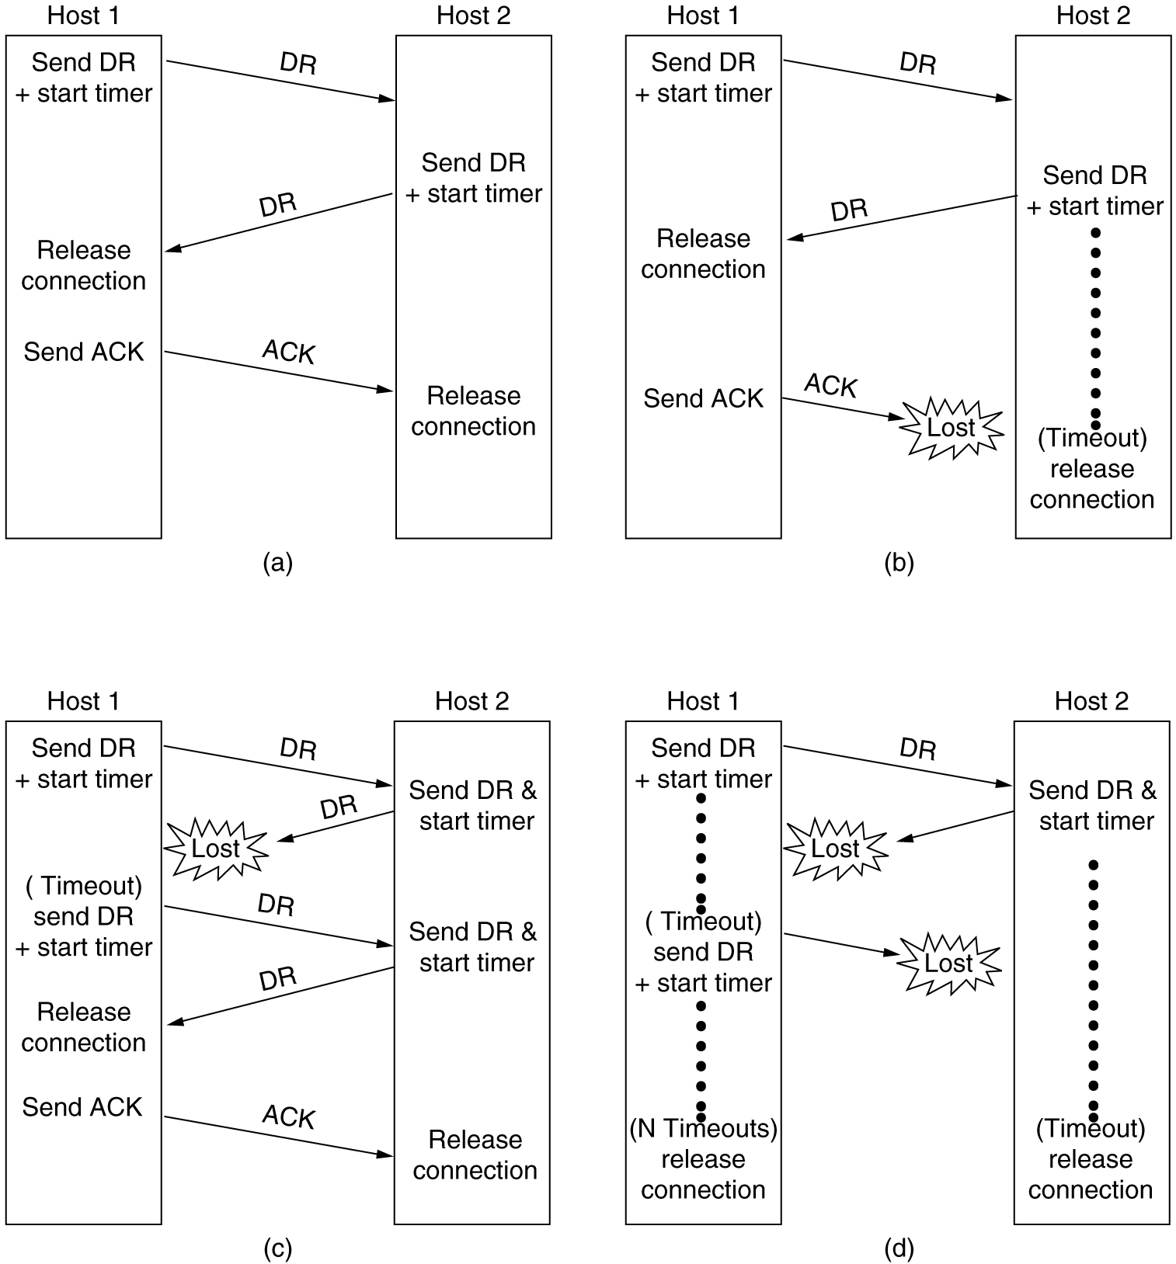
Connection Release (3)
6-14, a, b
Four protocol scenarios for releasing a connection. (a) Normal case of a three-way handshake. (b) final ACK lost.

Slide 16
Connection Release (4)
6-14, c,d
(c) Response lost. (d) Response lost and subsequent DRs lost.

Slide 17
The Internet Transport Protocols: UDP
Introduction to UDP

Slide 18
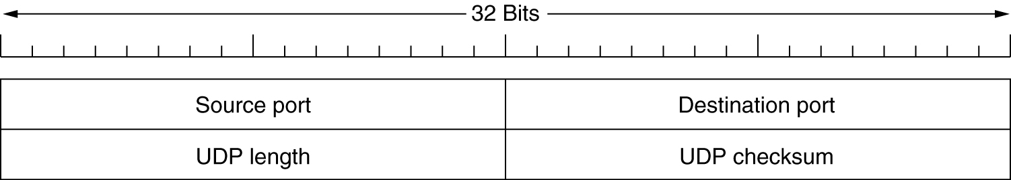
Introduction to UDP
The UDP header.

Slide 19
The Internet Transport Protocols: TCP
Introduction to TCP
The TCP Service Model
The TCP Protocol
The TCP Segment Header
TCP Connection Establishment
TCP Connection Release

Slide 20
The TCP Service Model
Port
Protocol
Use
21
FTP
File transfer
23
Telnet
Remote login
25
SMTP
E-mail
69
TFTP
Trivial File Transfer Protocol
79
Finger
Lookup info about a user
80
HTTP
World Wide Web
110
POP-3
Remote e-mail access
119
NNTP
USENET news
Some assigned ports.

Slide 21
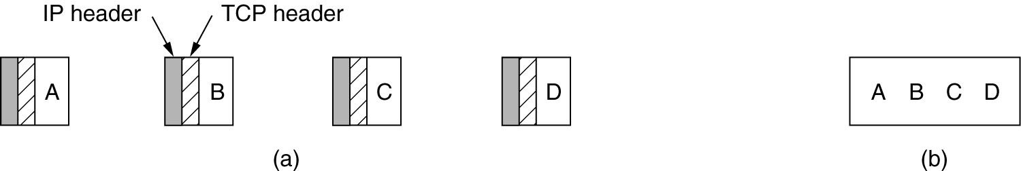
The TCP Service Model (2)
(a) Four 512-byte segments sent as separate IP datagrams.
(b) The 2048 bytes of data delivered to the application in a single READ CALL.

Slide 22
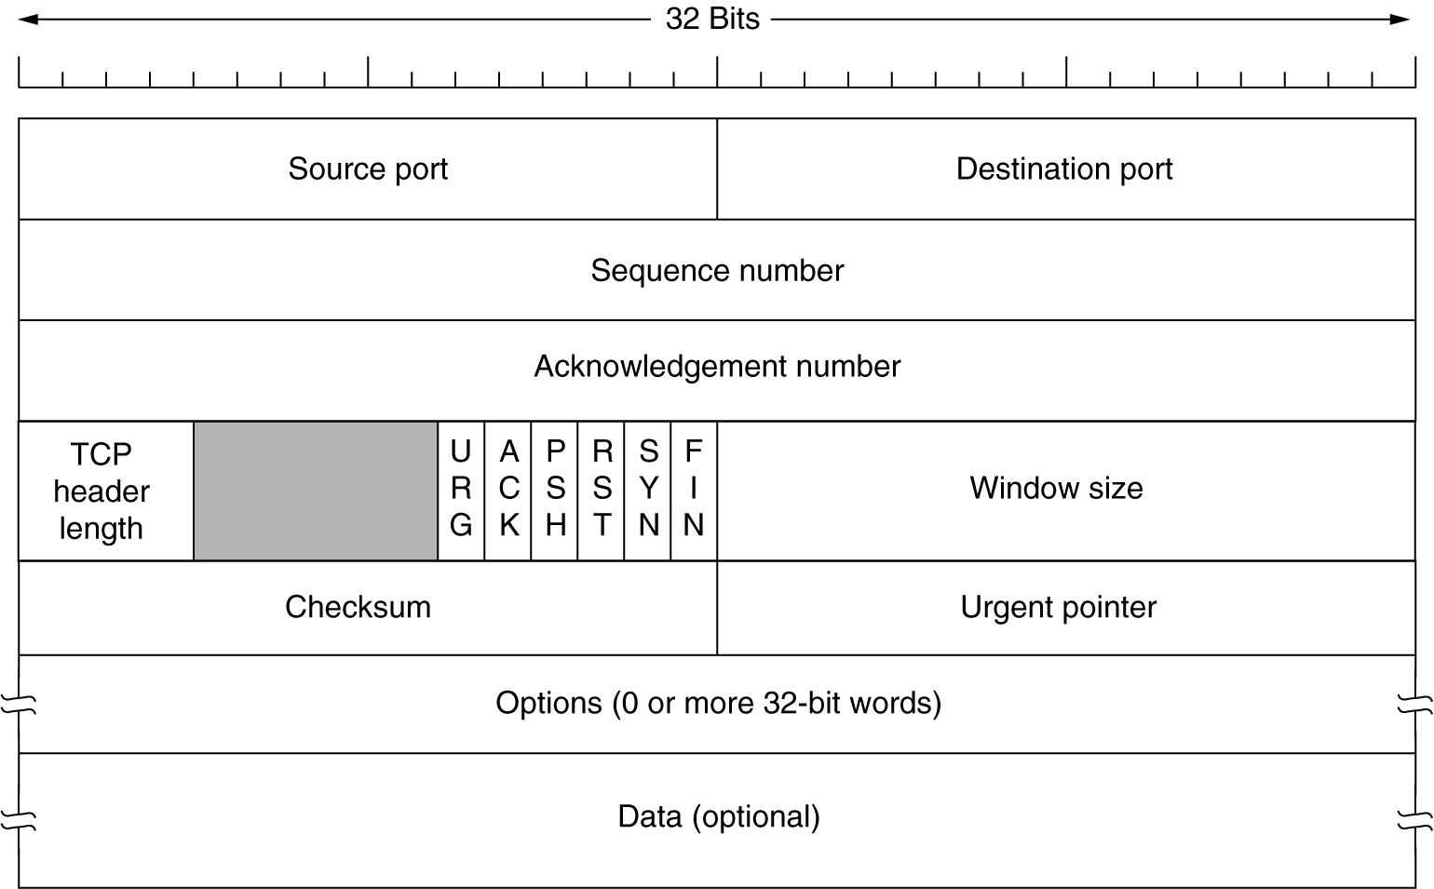
The TCP Segment Header
TCP Header.

Slide 23
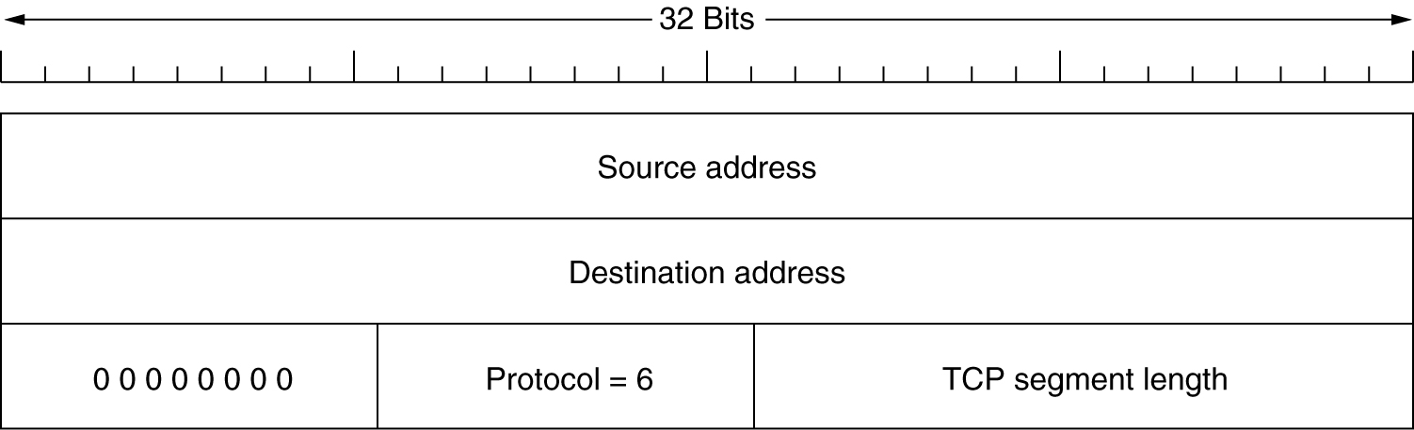
The TCP Segment Header (2)
The pseudoheader included in the TCP checksum.

Slide 24
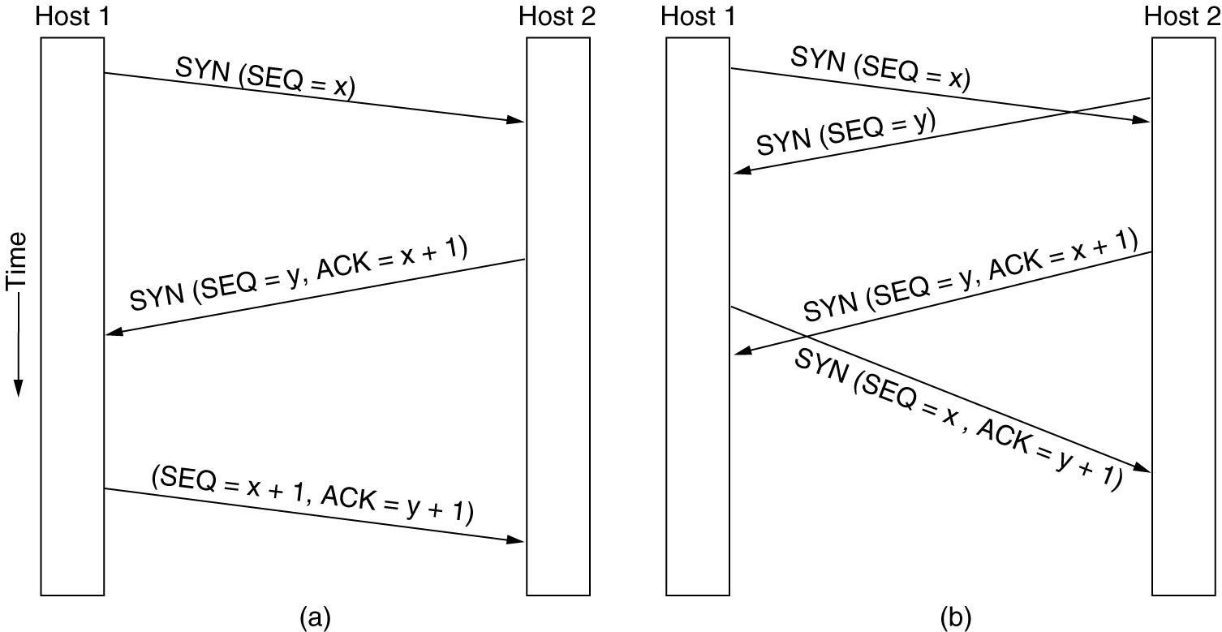
TCP Connection Establishment
6-31
(a) TCP connection establishment in the normal case.
(b) Call collision.

Slide 25
The Application Layer

Slide 26
DNS – The Domain Name System
The DNS Name Space
Resource Records
Name Servers

Slide 27
DNS
DNS is the invention of a hierarchical, domain-based naming scheme and a distributed database system for implementing the naming scheme.
DNS is used to map a name onto an IP address, an application program calls a library procedure called the Resolver, passing it the name as a parameter.
The Resolver sends a UDP packet to a local DNS server, which then looks up the name and returns IP address, the program can then establish a TCP connection with the destination or send it UDP packets.

Slide 28
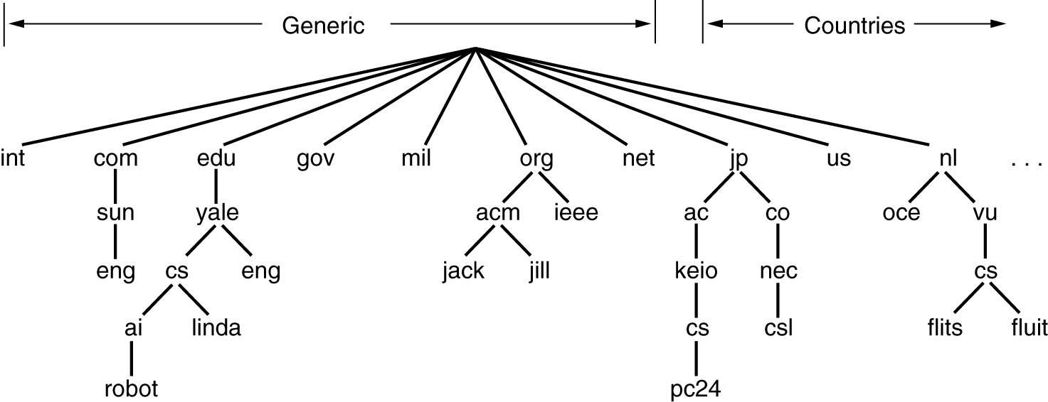
The DNS Name Space
A portion of the Internet domain name space.

Slide 29
DNS Name Space
Internet is divided into 200 top-level domains, where each domain covers many hosts.
Each domain is partitioned into subdomains, and these are further partitioned, and so on.
Top-level domains : Generic
Countries.
Generic Domains were com(commercial), edu(educational institutions), gov, int(international organizations), mil, net(network providers), and org(non profit organization).
The Country domains include one entry for every country.
Each domain is named by the path upward from it to the (unnamed) root.

Slide 30
DNS(contd..)
Domain names can be either absolute or relative.
An absolute domain name always ends with a period (e.g.,eng.sun.com)
Relative does not.
Domain names are case insensitive.
Domains can be inserted into the tree in two different ways.
Each domain controls how it allocates the domains under it.
To create a new domain, permission is required of the domain in which it will be included. So that name conflicts are avoided.
Once domain has been created & registered, it can create subdomains, without getting permission from anybody higher up the tree.

Slide 31
Resource Records
Every Domain, whether it is a single host or a top-level domain, can have a set of resource records associated with it.
For single host, the most common resource record is just its IP address, but many other kinds of resource records also exist.
When a resolver gives a domain name to DNS, it gets back resource records associated with that name. Thus, the primary function of DNS is to map domain names onto resource records.
A resource record is a five-tuple. The format is as follows:
Domain_name Time_to_live Class Type Value
Domain_name :tells the domain to which this record applies
Time_to_live field gives an indication of how stable the record is.
Class: For Internet information, it is always IN
For non-Internet information, other codes can be used.

Slide 32
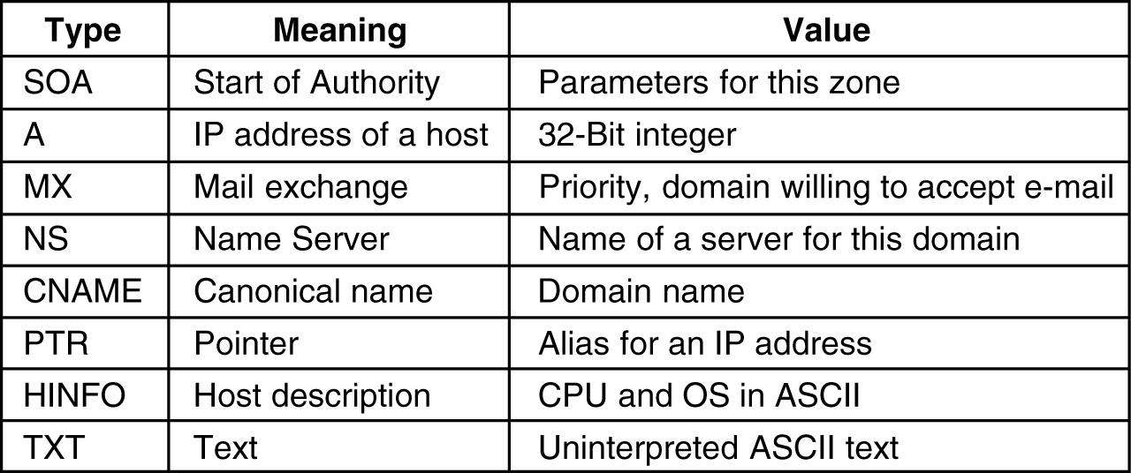
Resource Records
Type: This field tells what kind of record this is. The important types are listed below
The principal DNS resource records types.
Value: This can be a number, a domain name, or an ASCII string.

Slide 33
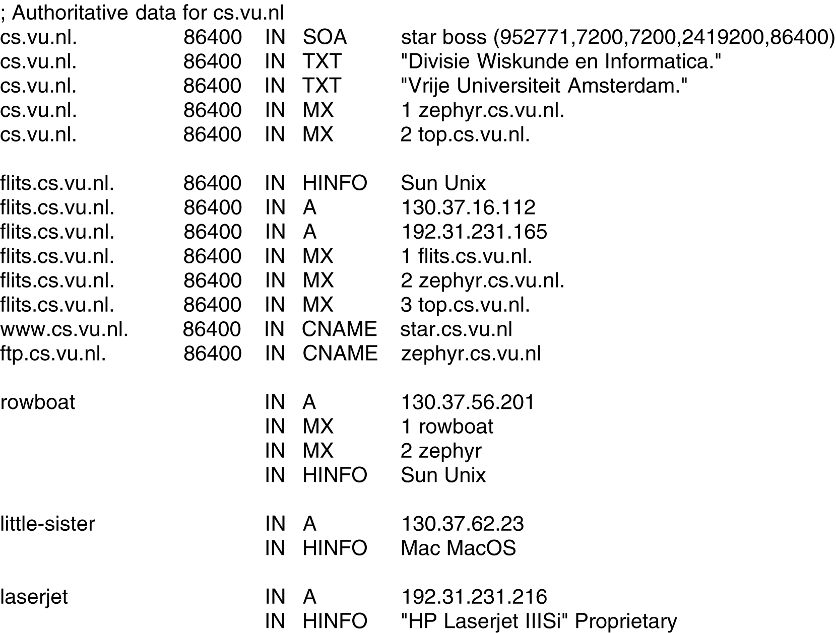
Resource Records (2)
A portion of a possible DNS database for cs.vu.nl.

Slide 34
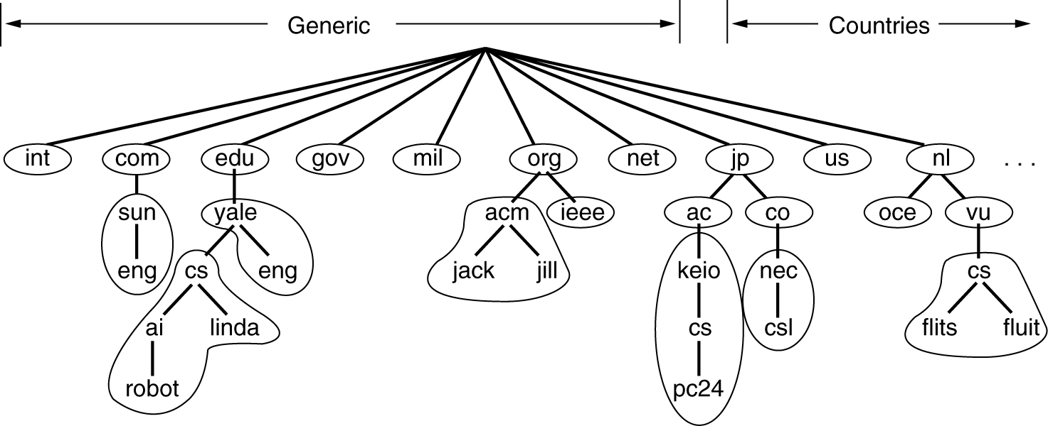
Name Servers
Part of the DNS name space showing the division into zones.

Slide 35
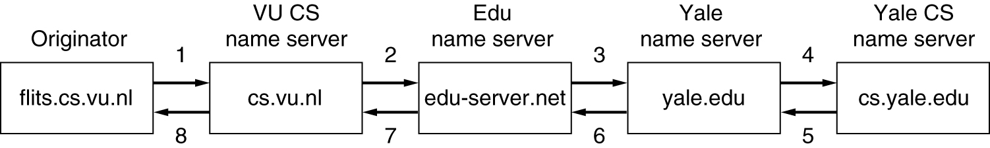
Name Servers (2)
How a resolver looks up a remote name in eight steps.

Slide 36
The World Wide Web
Architectural Overview
Static Web Documents
Dynamic Web Documents
HTTP – The HyperText Transfer Protocol
Performance Ehnancements
The Wireless Web

Slide 37
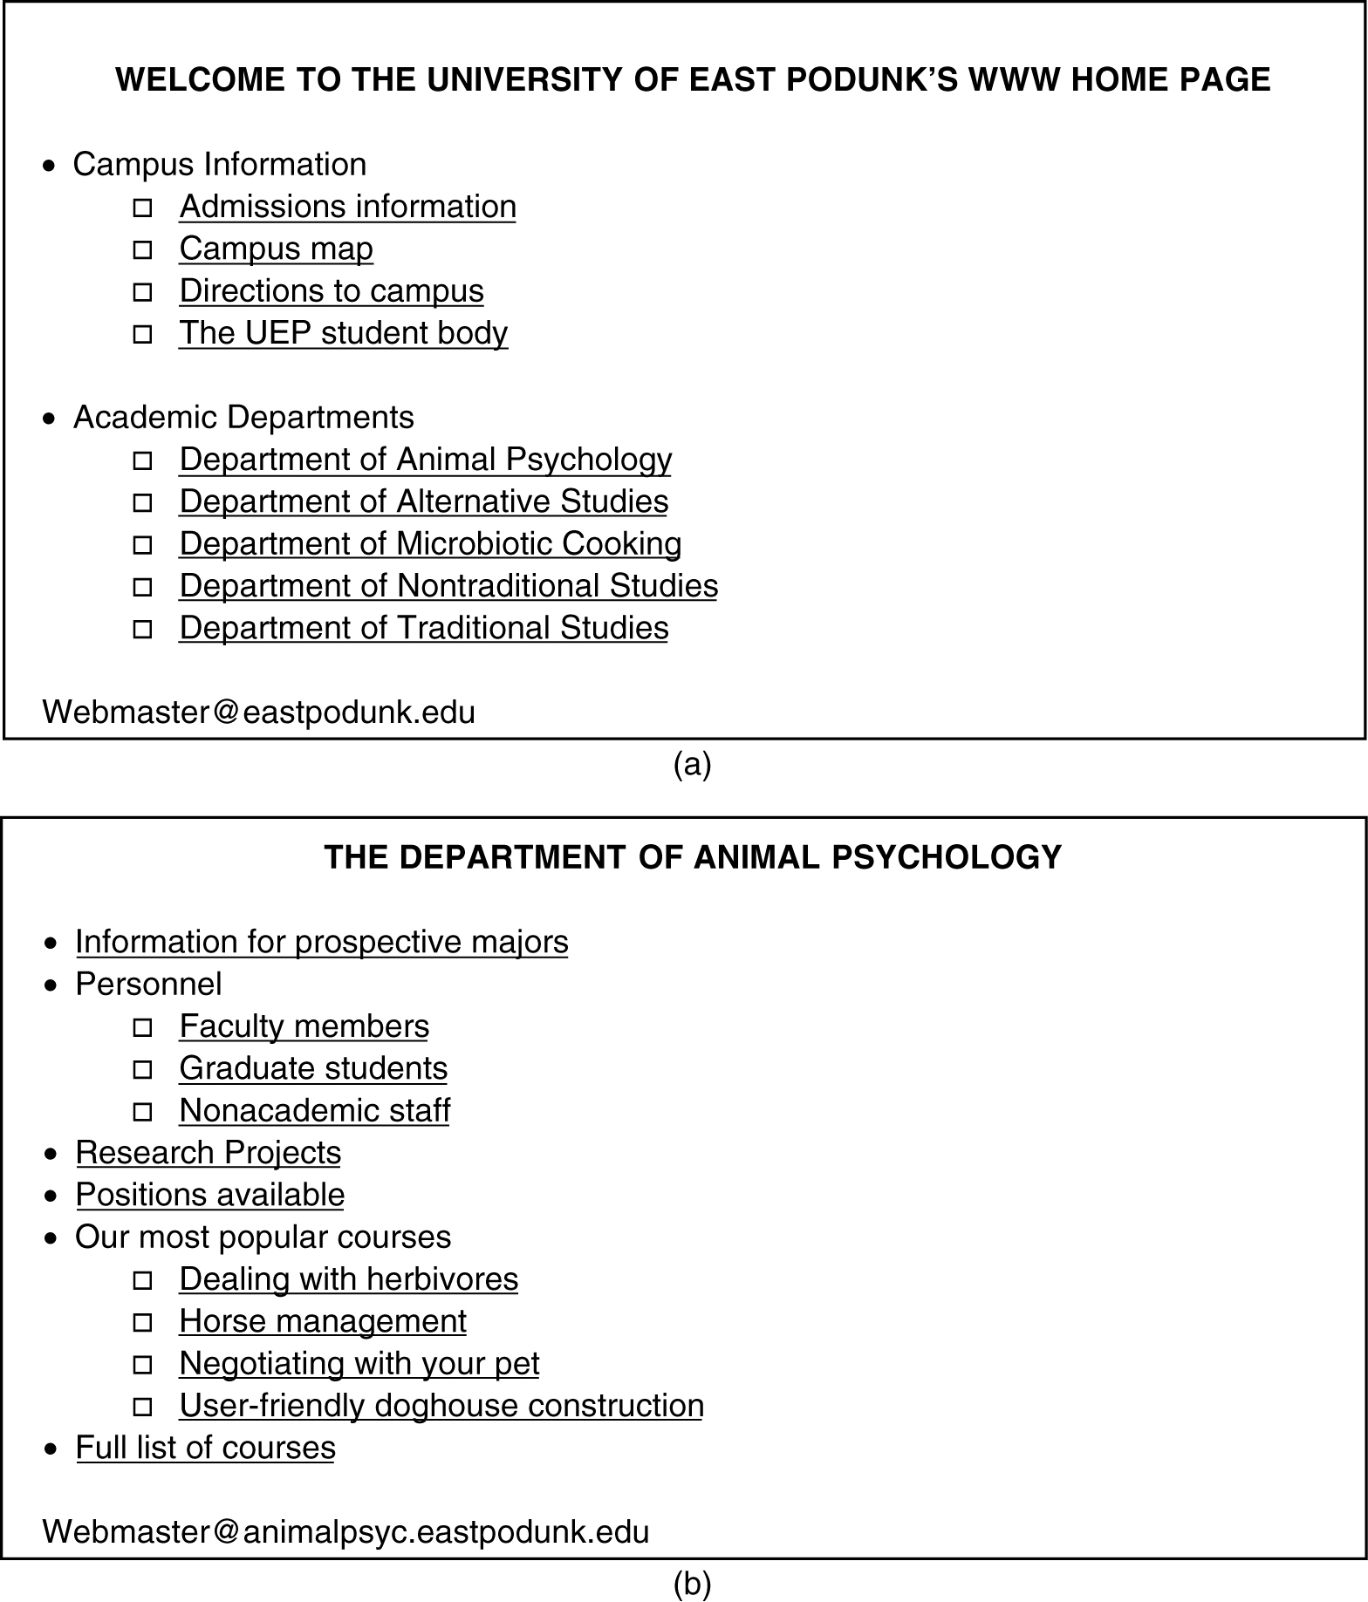
Architectural Overview
(a) A Web page (b) The page reached by clicking on
Department of Animal Psychology.

Slide 38
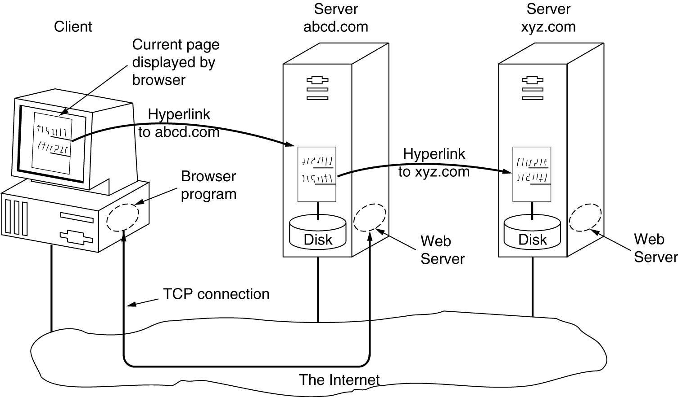
Architectural Overview (2)
The parts of the Web model.

Slide 39

Architecture of WWW
The WWW today is a distributed client/server service, in which a client using a browser can access a service using a server. However, the service provided is distributed over many locations called sites.
Computer Networks
27-<number>

Slide 40
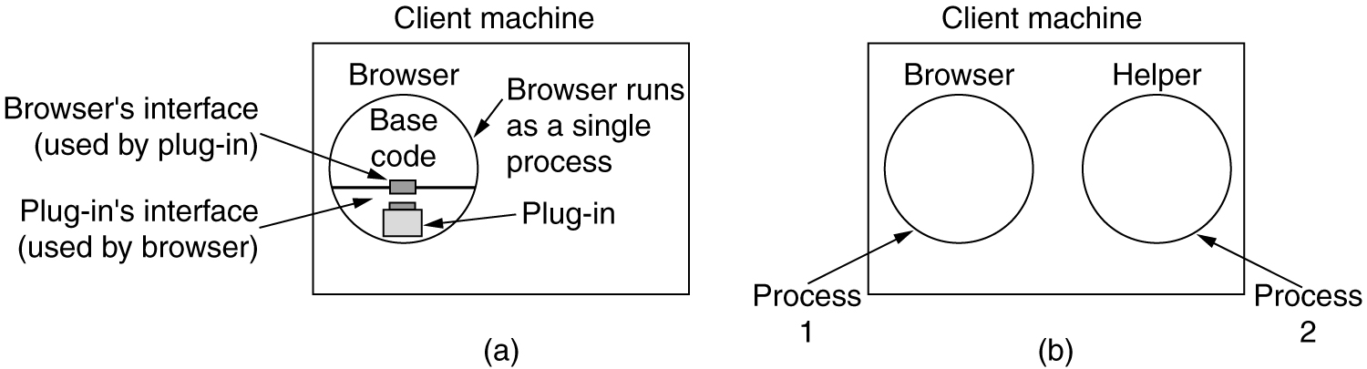
The Client Side
(a) A browser plug-in. (b) A helper application.

Slide 41
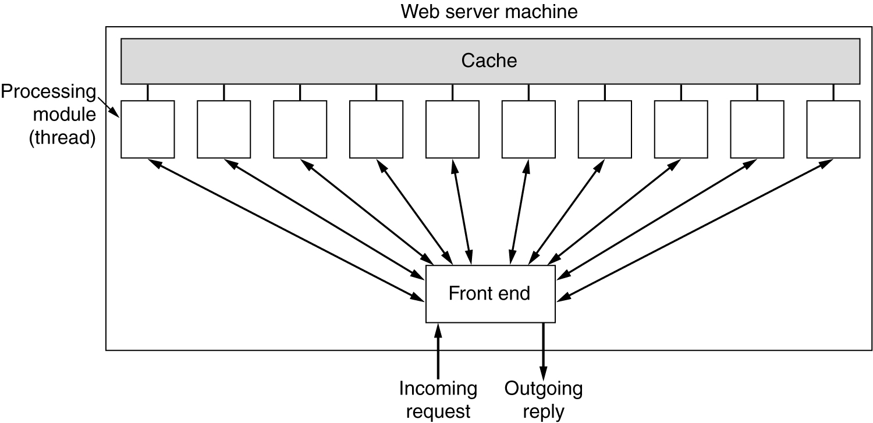
The Server Side
A multithreaded Web server with a front end and processing modules.

Slide 42
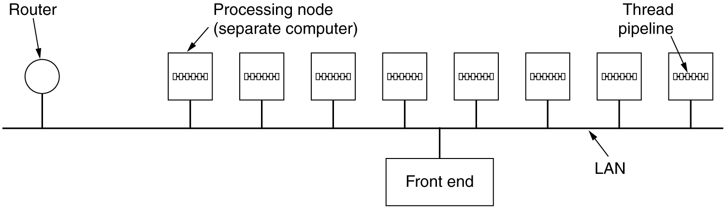
The Server Side (2)
A server farm.

Slide 43
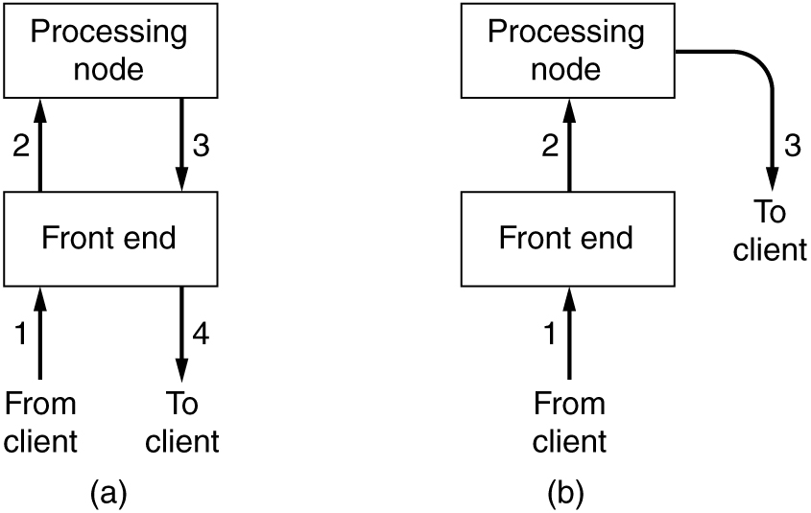
The Server Side (3)
(a) Normal request-reply message sequence.
(b) Sequence when TCP handoff is used.

Slide 44
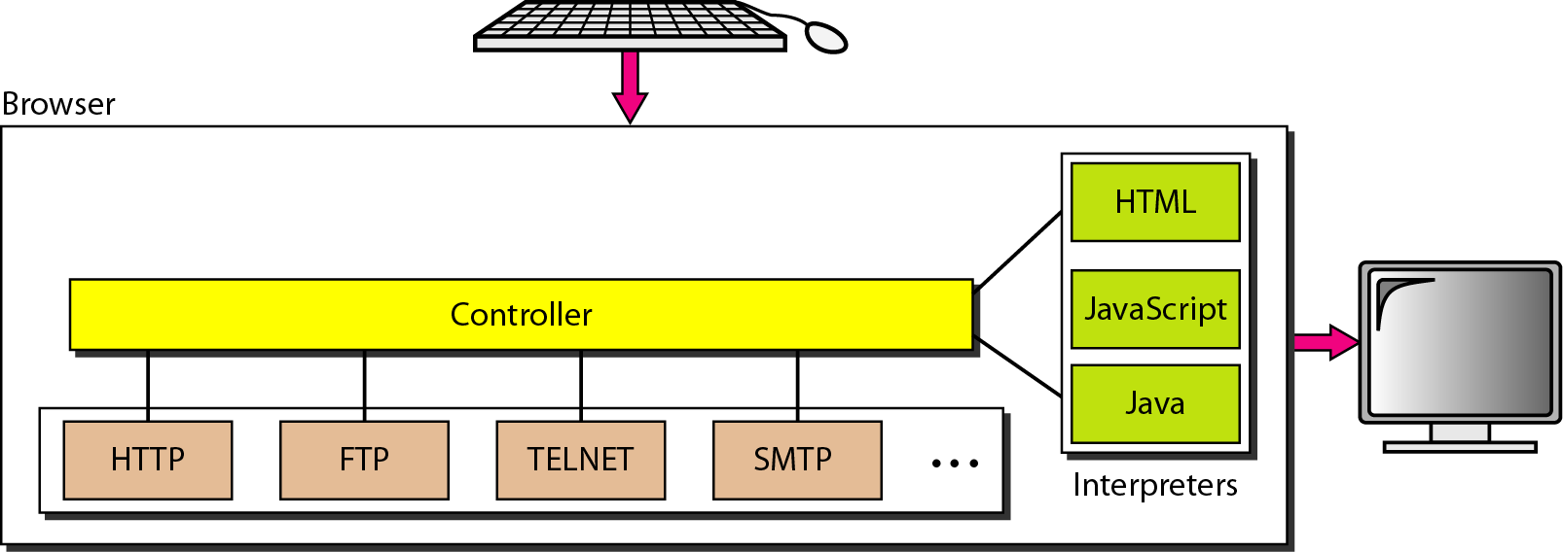
Browser and URL
Uniform Resource Locator
Cookies ??
Computer Networks
27-<number>

Slide 45
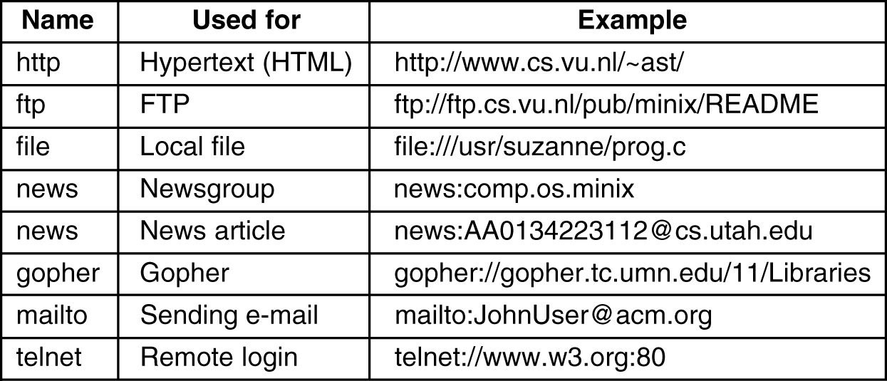
URLs – Uniform Resource Locaters
Some common URLs.

Slide 46
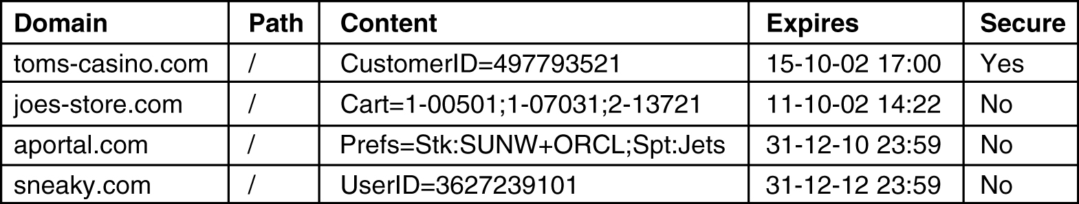
Statelessness and Cookies
Some examples of cookies.

Slide 47
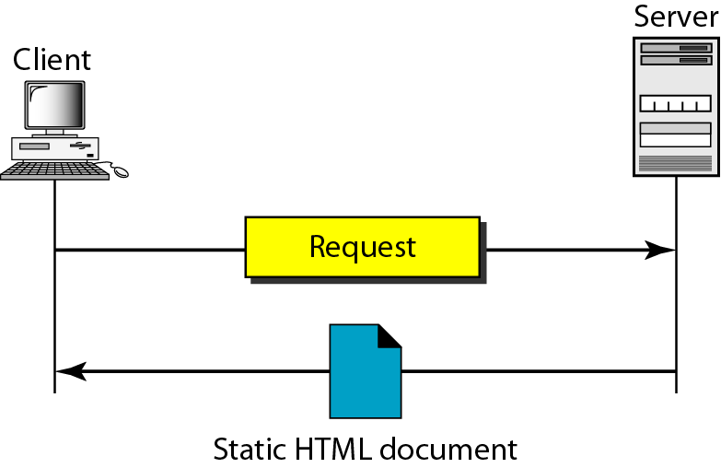
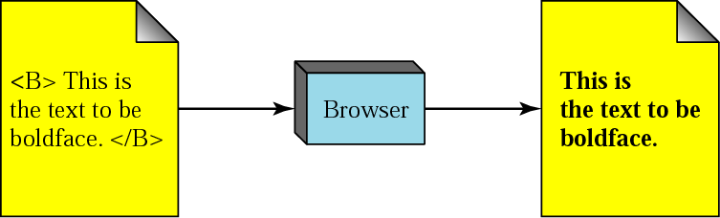
Static Documents: HTML
Computer Networks
27-<number>

Slide 48
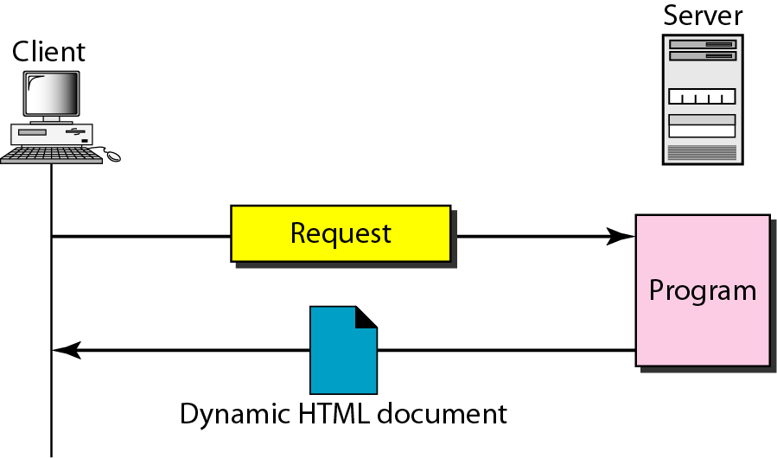
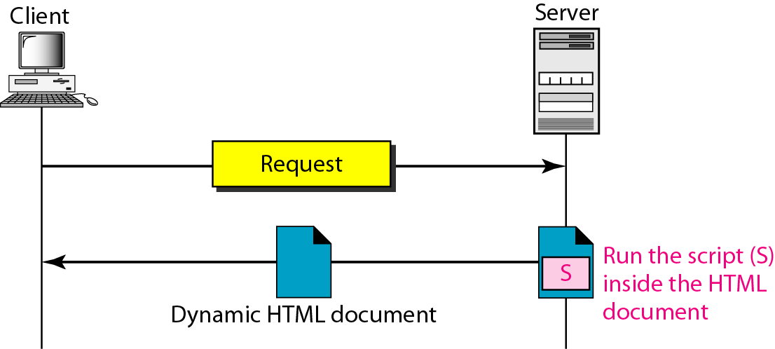
Dynamic Documents: CGI and Scripting
Common Gateway Interface
Server-site Script
Computer Networks
27-<number>

Slide 49
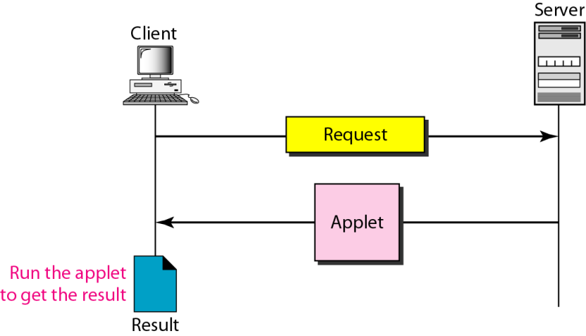
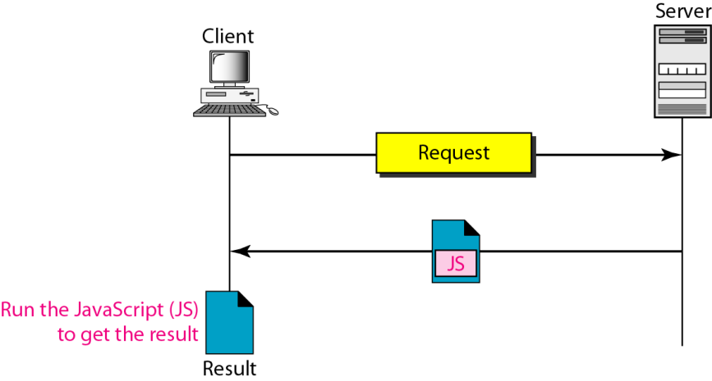
Active Documents: Java Applets and JavaScript
Active document using Java applet
Active document using client-site script
Computer Networks
27-<number>
Computer Networks
27-<number>

Slide 50
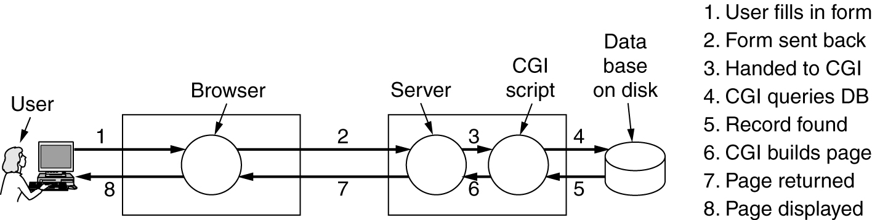
Dynamic Web Documents
Steps in processing the information from an HTML form.

Slide 51
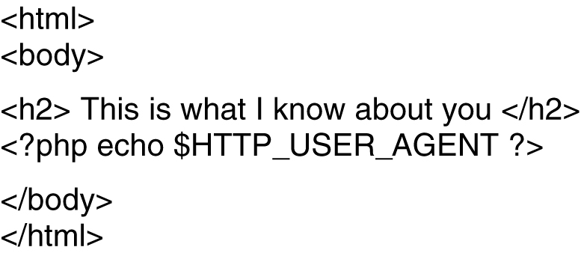
Dynamic Web Documents (2)
A sample HTML page with embedded PHP.

Slide 52
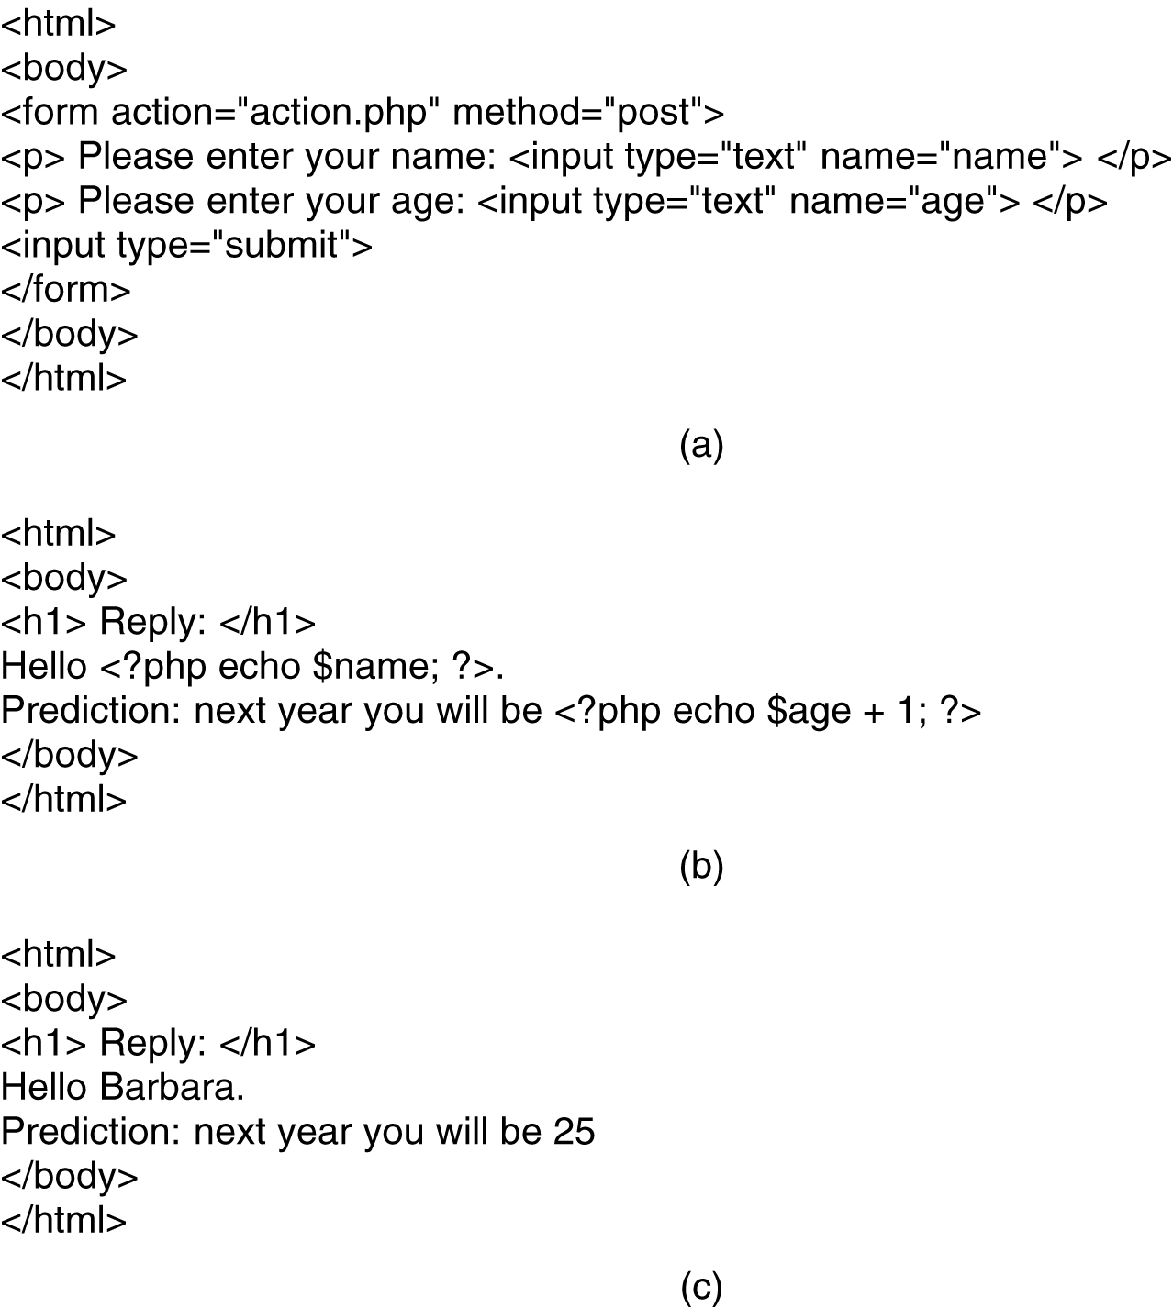
Dynamic Web Documents (3)
(a) A Web page containing a form. (b) A PHP script for handling the output of the form. (c) Output from the PHP script when the inputs are "Barbara" and 24 respectively.

Slide 53
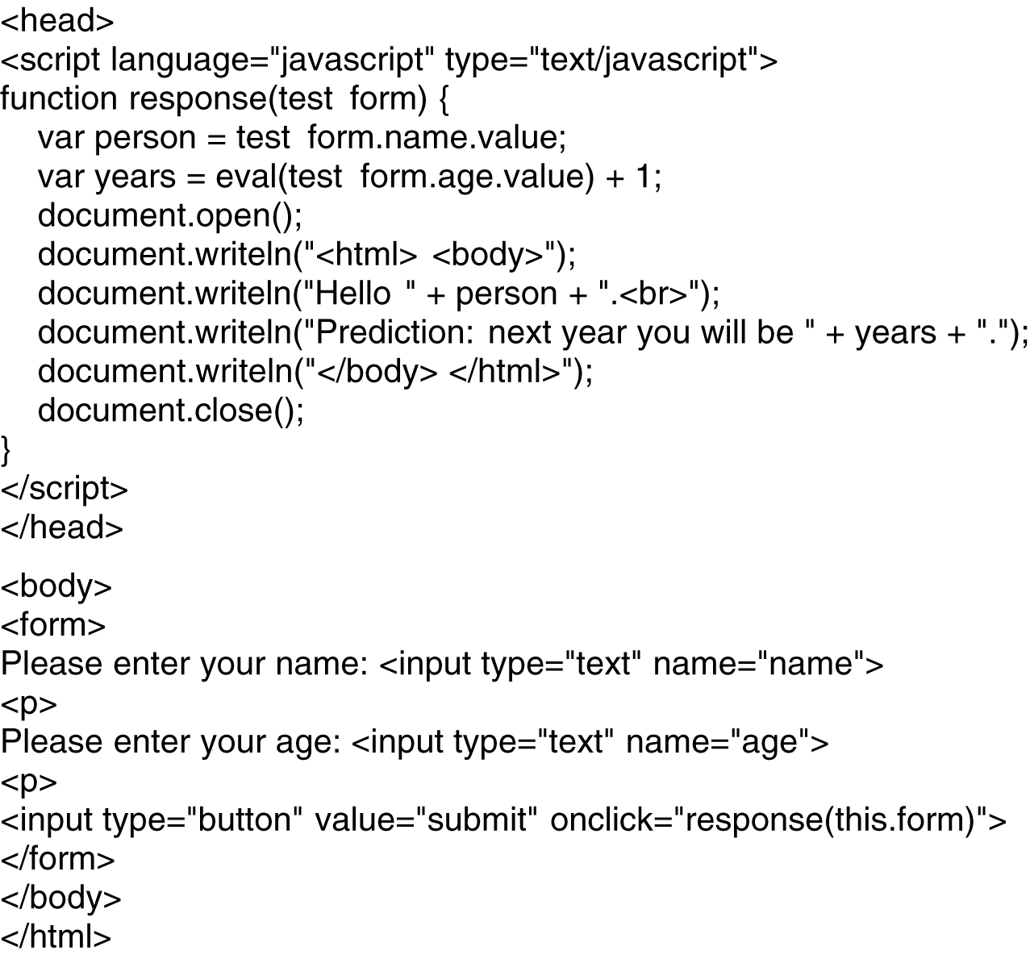
Client-Side Dynamic Web Page Generation
Use of JavaScript for processing a form.

Slide 54
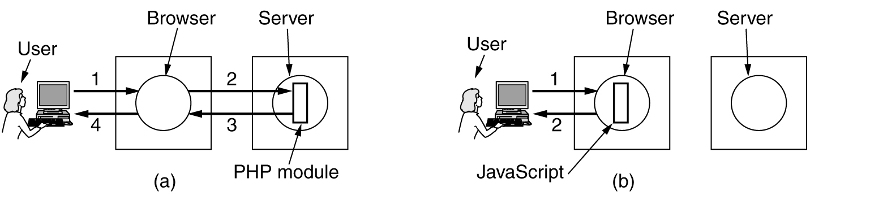
Client-Side Dynamic Web Page Generation (2)
(a) Server-side scripting with PHP.
(b) Client-side scripting with JavaScript.

Slide 55
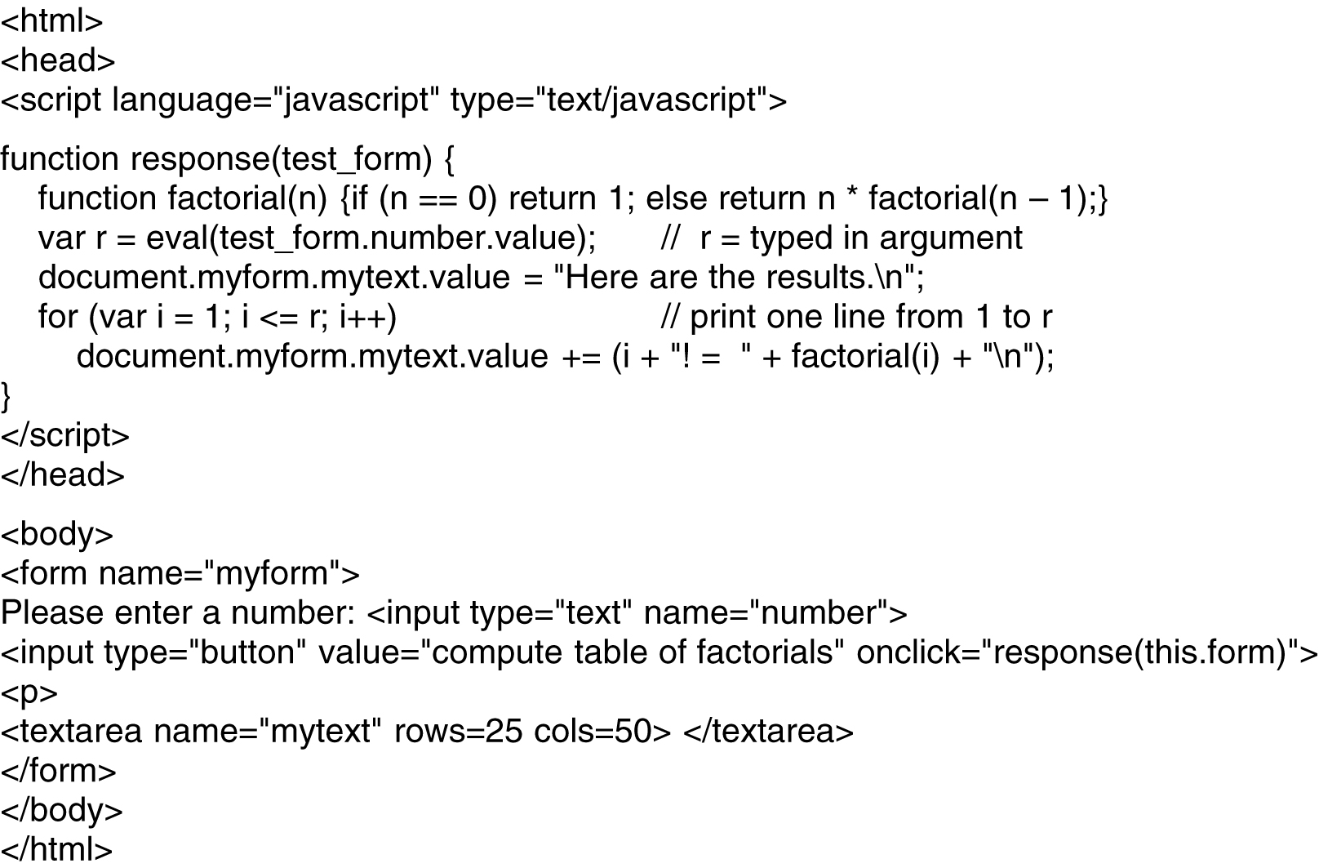
Client-Side Dynamic Web Page Generation (3)
A JavaScript program for computing and printing factorials.

Slide 56
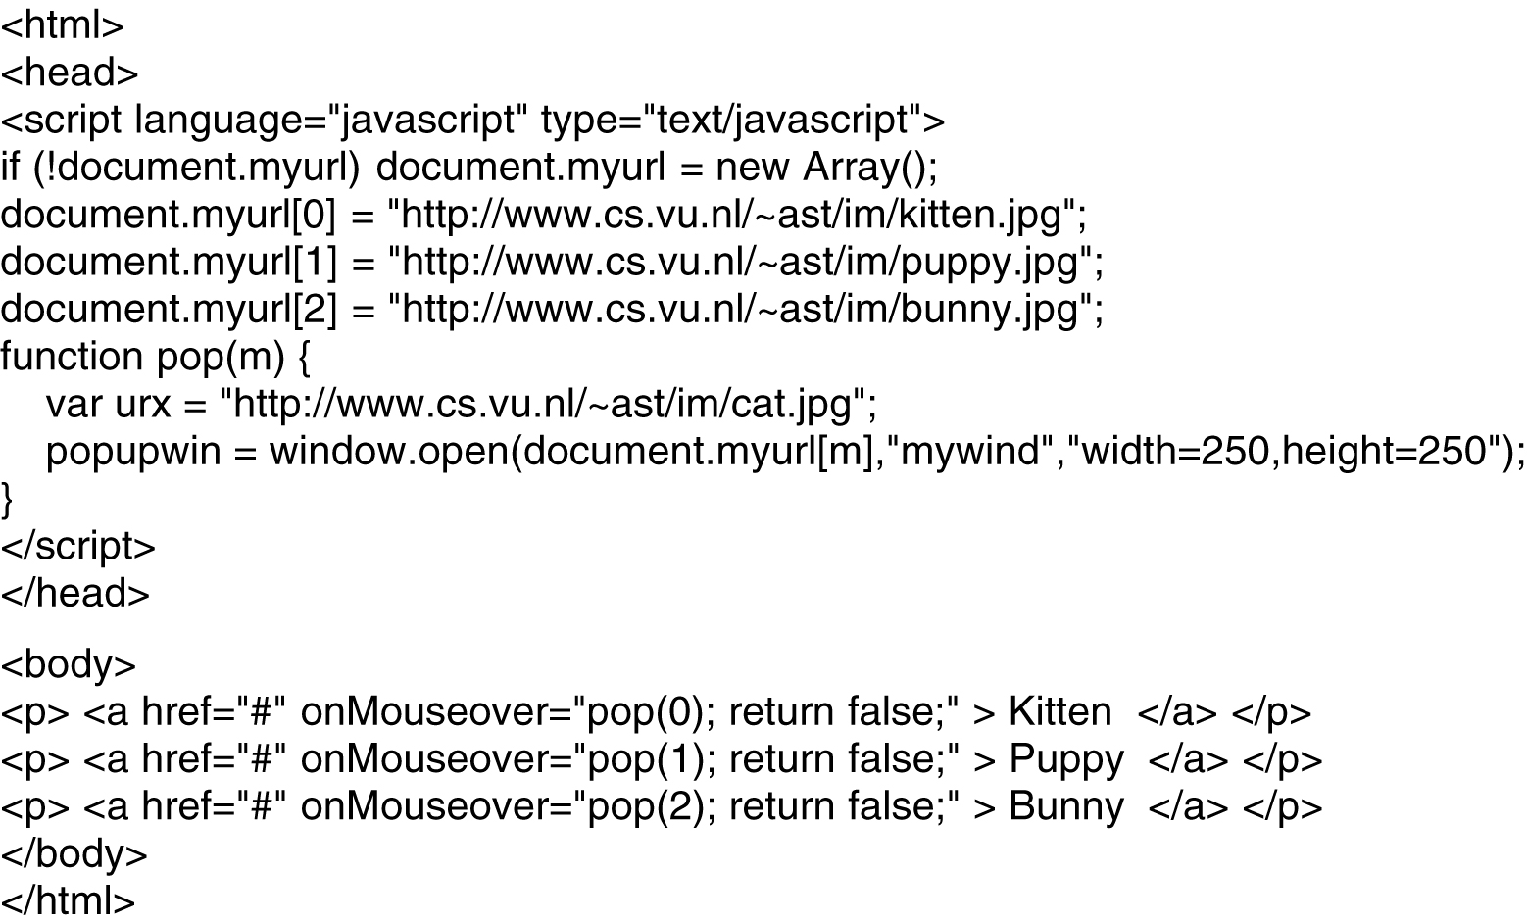
Client-Side Dynamic Web Page Generation (4)
An interactive Web page that responds to mouse movement.

Slide 57
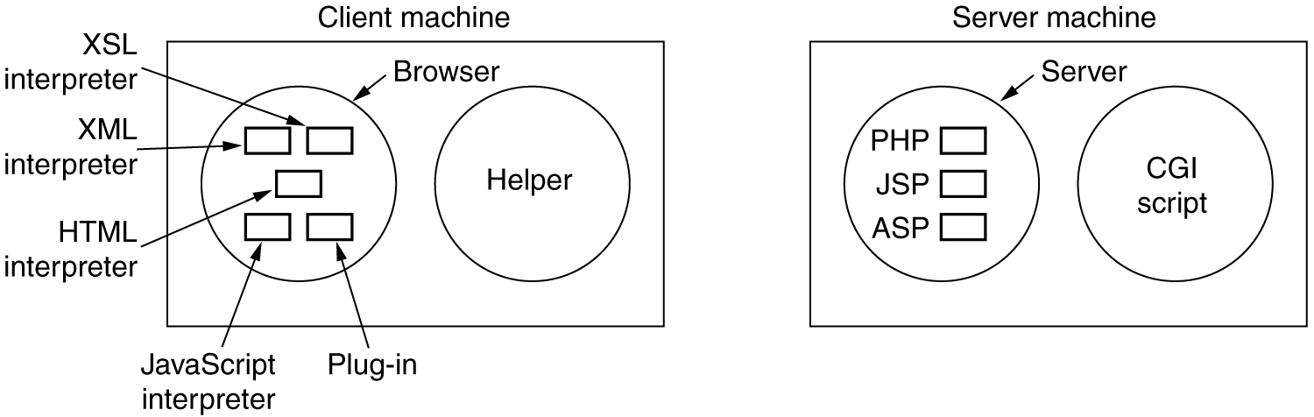
Client-Side Dynamic Web Page Generation (5)
The various ways to generate and display content.

Slide 58
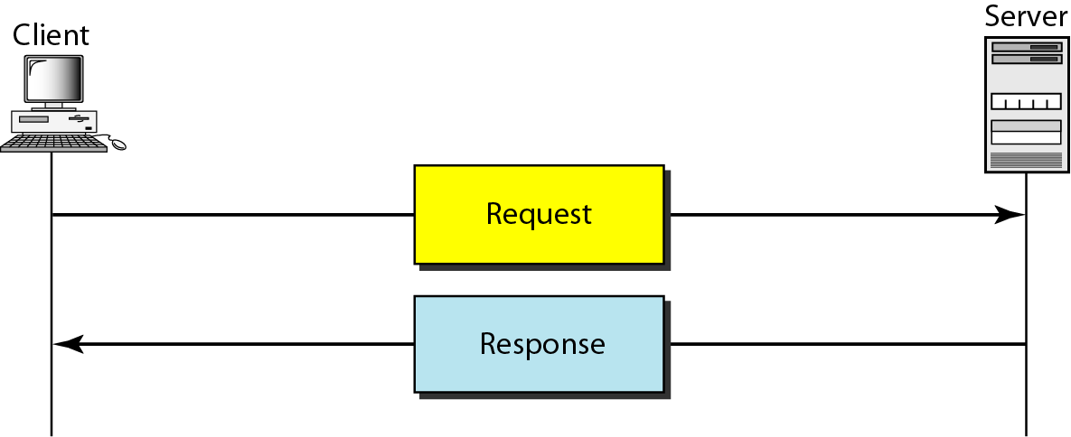
Hypertext Transfer Protocol (HTTP)
HTTP is used mainly to access data on the WWW
HTTP uses the services of TCP on well-known port 80
Computer Networks
27-<number>

Slide 59
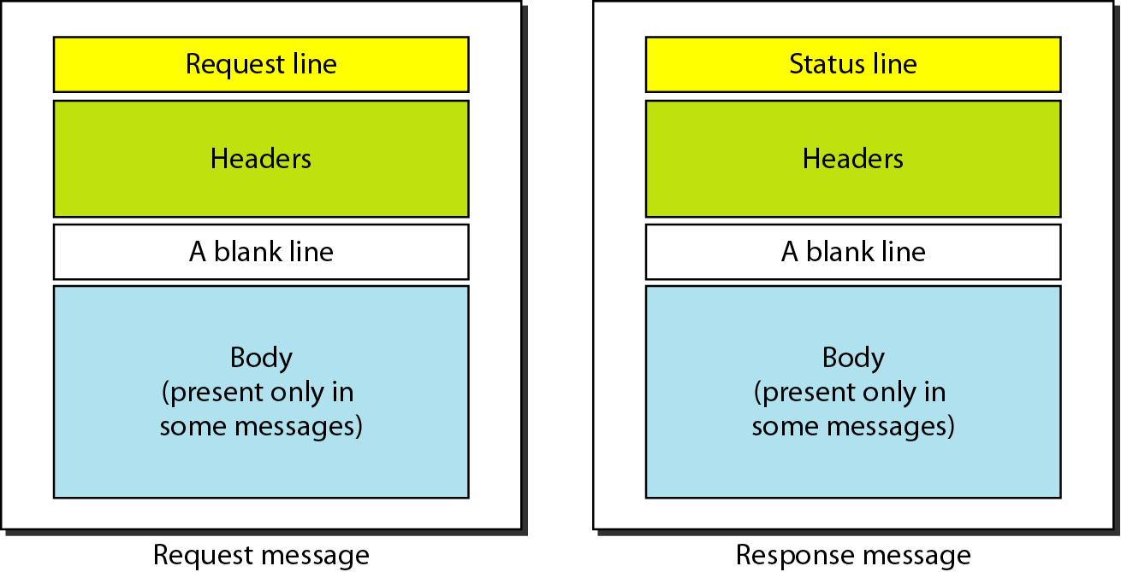
Request and Response Message
Computer Networks
27-<number>

Slide 60
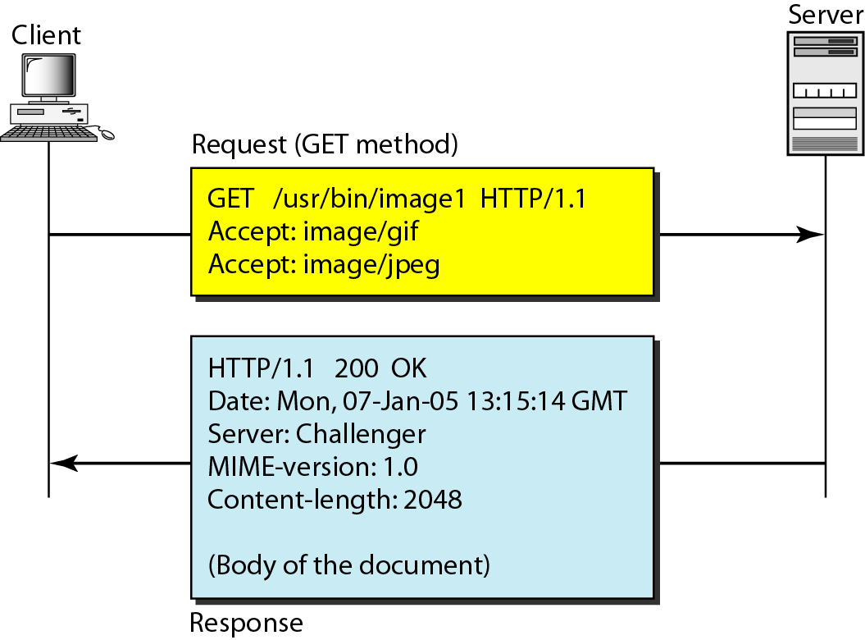
Example 1
Computer Networks
27-<number>

Slide 61
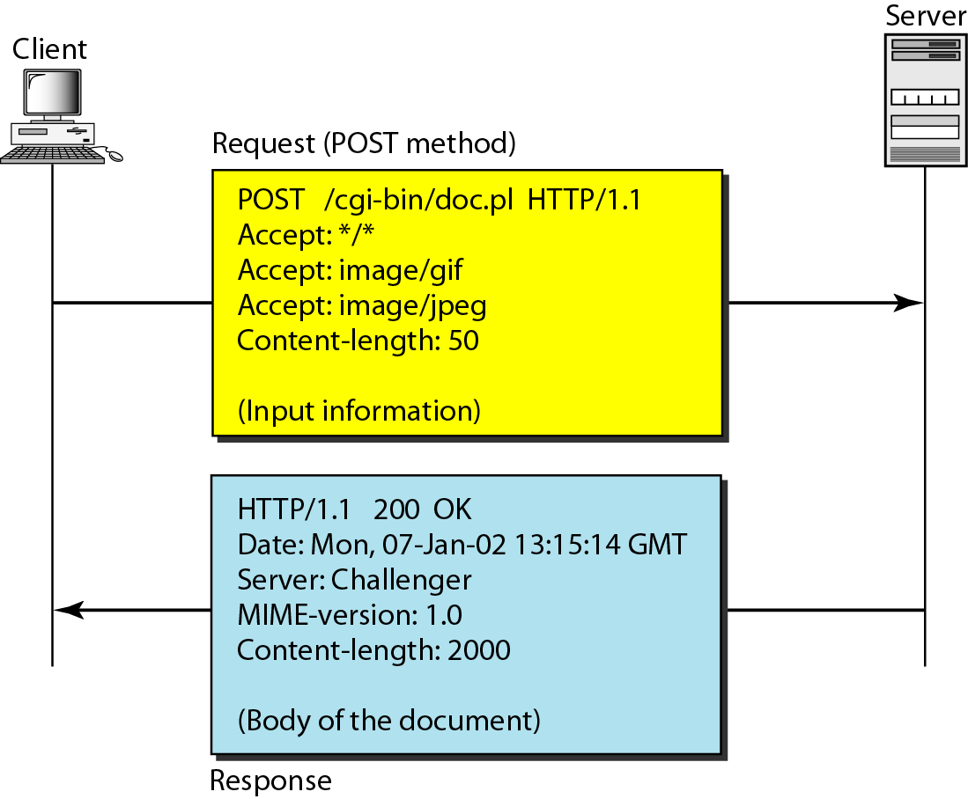
Example 2
Computer Networks
27-<number>

Slide 62
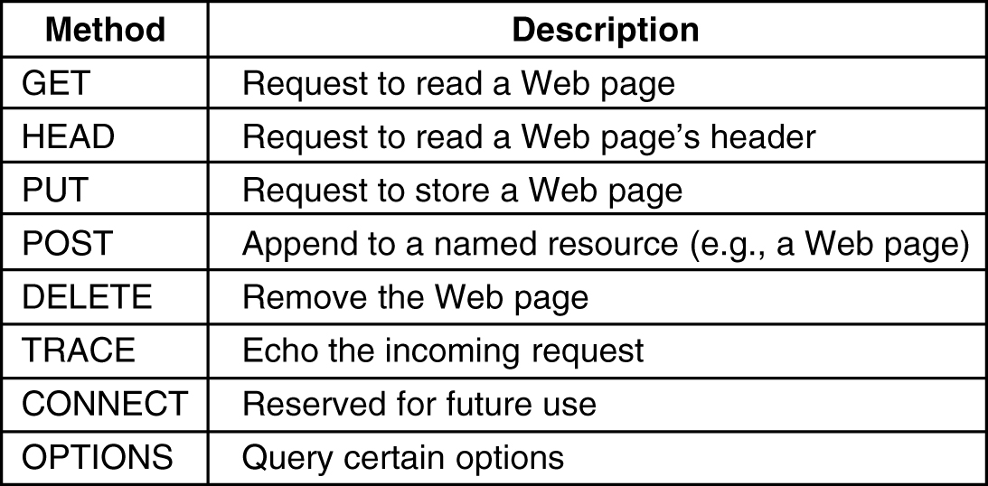
HTTP Methods
The built-in HTTP request methods.

Slide 63

HTTP Methods (2)
The status code response groups.

Slide 64

HTTP Message Headers
Some HTTP message headers.

Slide 65

Example HTTP Usage
The start of the output of www.ietf.org/rfc.html.

Slide 66

Caching
Hierarchical caching with three proxies.

Slide 67

File Transfer
FTP uses the services of TCP. It needs two TCP connections. The well-known port 21 is used for the control connection, and the well-known port 20 is used for the data connection.
Computer Networks
26-<number>

Slide 68


Communication over Two Connections
Computer Networks
26-<number>

Slide 69


Electronic Mail
When the sender and the receiver of an e-mail are on the same system, we need only two user agents.
When the sender and the receiver of an e-mail are on different systems, we need two UAs and a pair of MTAs (client and server).
Computer Networks
26-<number>

Slide 70

Electronic Mail
When the sender is connected to the mail server via a LAN or a WAN, we need two UAs and two pairs of MTAs (client and server).
Computer Networks
26-<number>

Slide 71

Electronic Mail
When both sender and receiver are connected to the mail server via a LAN or a WAN, we need two UAs, two pairs of MTAs and a pair of MAAs. This is the most common situation today.
Computer Networks
26-<number>

Slide 72

User Agent
Services provided by a user agent
Command-driven user agents: mail, pine, and elm.
GUI-based user agents: Eudora, Outlook, and Netscape.
Computer Networks
26-<number>

Slide 73

Format of an E-mail
Computer Networks
26-<number>

Slide 74

Email address
The local port defines the name of a special file, called the user mailbox, where all the mail received for a user is stored for retrieval by the user agent
Computer Networks
26-<number>

Slide 75

MIME
Multipurpose Internet mail Extensions (MIME)
Supplementary protocol that allows non-ASCII data to be sent through SMTP
Computer Networks
26-<number>

Slide 76


Mail Transfer Agent (MTA): SMTP
The actual mail transfer is done through MTA
Computer Networks
26-<number>

Slide 77
SMTP Functioning
Three phases of transfer:
● handshaking: Connection establishment
● transfer: direct transfer from sending server (client) to receiving server (server); pushbased: client sends data instead of server
● closure: Connection termination

Slide 78

SMTP
SMTP clients and servers have two main components
● User Agents – Prepares the message, encloses it in an envelope.
● Mail Transfer Agent (MTA) – Transfers the mail across the internet
● To send mail, a system must have the client MTA, and to receive mail, a system must have a server MTA
.

Slide 79

SMTP

Slide 80

SMTP

Slide 81
Mail Access Agent: POP and IMAP
The third stage: pull protocol (SMTP is a push protocol for the first/second stages)
Two mail access protocols
  Post Office Protocol, version 3 (POP3)
  Internet Mail Access Protocol, version 4 (IMAP4)
POP3 is simple and limited in functionality
IMAP4 is similar to POP3, but has more features with extra functions
  A user can check the email header prior to downloading
  A user can search the contents of the email for a specific string of characters prior to downloading
  A user can create, delete, or rename mailboxes on the mail server
  A user can create a hierarchy of mailboxes in a folder for email storage
Computer Networks
26-<number>

Slide 82
POP3
Post Office Protocol (POP3)
● Used in conjunction with an SMTP Host
SMTP Host sends and receives e-mail for remote users
POP allows users to retreive their mail from the host
SMTP stores mail for unconnected hosts
● RFC 1730
● TCP Port 110

Slide 83

POP3 and IMAP4
Computer Networks
26-<number>

Slide 84

POP3
Computer Networks
26-<number>

Slide 85
IMAP
IMAP
● Developed after POP and attempts to fix POP deficiencies
● allows keeping all mail on the server
● allows mail categorization via folder metaphor
● mail is easily flagged (answered, draft, deleted, seen, recent); this isn’t the same on all servers
● provides for multiple connections to the server

Slide 86
POP3 vs IMAP4
With IMAP4, all your mail stays on the server in multiple folders, some of which you have created
With POP3 you only have one folder, the Inbox folder. When you open your mailbox, new mail is moved from the host server and saved on your computer. If you want to be able to see your old mail messages, you have to go back to the computer where you last opened your mail
With POP3 "leave mail on server" only your email messages are on the server, but with IMAP your email folders are also on the server

Slide 87
MIME extension to SMTP
MIME – Multipurpose Internet Mail Extensions
● Transforms non-ASCII data to NVT (Network Virtual Terminal) ASCII data
– Text
– Application
– Image
– Audio
– Video

Slide 88

MIME Header
To transform non-ASCII data to ASCII data
Computer Networks
26-<number>

Slide 89

Content-Transfer-Encoding
Computer Networks
26-<number>

Slide 90

Contd..

Slide 91

MIME – Base 64 encoding

